Slide 1
Monetary Authority of Singapore
July 29, 2015
Regulatory Requirements and their Impact on Solvency, Liquidity and Interconnectedness:
An Agent-Based Analysis
Jorge A. Chan-Lau
International Monetary Fund, R.H. Smith School of Business, and Risk Management Institute, National University of Singapore
The views expressed here are those of the author and do not reflect those of the IMF nor IMF policy

Slide 2
Overview
Motivation
ABBA: Agent-Based Framework for Bank Analysis
An Application: Regulatory Requirements
  Solvency
  Liquidity
  Interconnectedness
Conclusions and Going Forward

Slide 3
Motivation

Slide 4
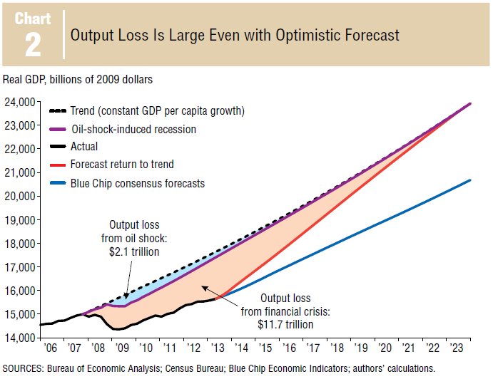
Financial Crises: Frequent and Costly
Lutrell, Atkinson, and Rosenblum, 2013, “Assessing the Costs and Consequences of the 2007-9 Financial Crisis
and its Aftermath,” Economic Letter, Vol. 8, No. 7, September, Federal Reserve Bank of Dallas

Slide 5
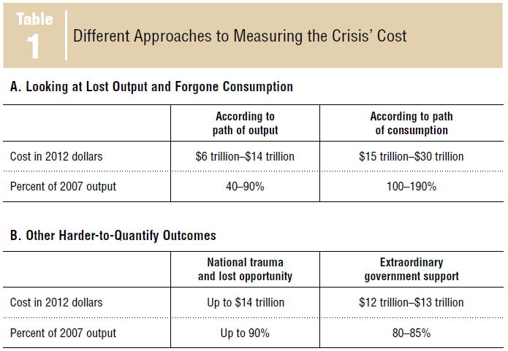

Financial Crises: Frequent and Costly
Lutrell, Atkinson, and Rosenblum, 2013, “Assessing the Costs and Consequences of the 2007-9 Financial Crisis
and its Aftermath,” Economic Letter, Vol. 8, No. 7, September, Federal Reserve Bank of Dallas

Slide 6
Policy Response: Enhanced regulation
Basel III: Better risk absorption in banks
  Higher and better capital buffers
  Liquidity Coverage
  Liquidity Monitoring Tools
Dodd-Frank (United States)
Impact of regulation
  Dynamic General Equilibrium Models (DSGEs)
  Econometric Models (VARs, ECMs, etc)

Slide 7
Why not DSGE
Equilibrium focus
  Crisis is out-of-equilibrium event!
Representative agent (or family, dinasty, etc)
  Owns banks, production factors, etc
Restrictive assumptions to introduce heterogeneity
Emphasis on rationality and optimization
“Historical” calibration or parameter estimation
  Past not equal to present
Cannot deal with complex adaptive behavior
  But agents react to changes in playing field!

Slide 8
What we need
Multiagent analytical framework
  Savers
  Banks
  Non-bank financial institutions
Heterogeneity within agent classes
Adaptive behavior
Non-rational and non-optimizing behavior allowed
Options
  Multiagent algorithmic, game theoretic models
  Agent-based models

Slide 9
Agent-Based Models
Anselmo and Planck (2012): lender of last resort
Axtell et al (2014): housing markets, mortgages
Aymanns and Farmer (2014): VaR and leverage
Bookstaber et al (2014): interbank funding market
Grilli et al (2012): bankruptcy and business cycle
Ismail (2012): bank formation, interbank market
Klinger and Teply (2014): stress test banking system
Lenzu and Tedeschi (2012), Georg (2013): contagion in banking networks
Montagna and Koc (2013): interbank exposures
Complexity Research Initiative for Systemic Instabilities: large scale ABMs for Eurozone

Slide 10
ABBA:
An Agent-Based Framework for Bank Analysis

Slide 11
What ABBA brings to the table
Common elements with earlier models but …
Integrates
  Broader set of agents:
    Savers, banks, loans
  Endogenous interbank network formation
  Richer set of behavioral bank's decisions
    Rebalancing of loan portfolios
    Dividend paying rules
  Second round-effects
    Domino effects in bank failures
Room for expanding framework

Slide 12
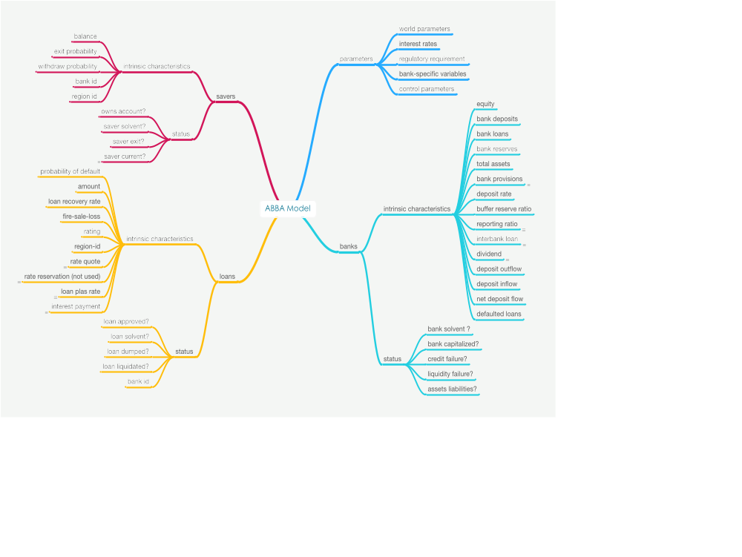
NetLogo Implementation

Slide 13
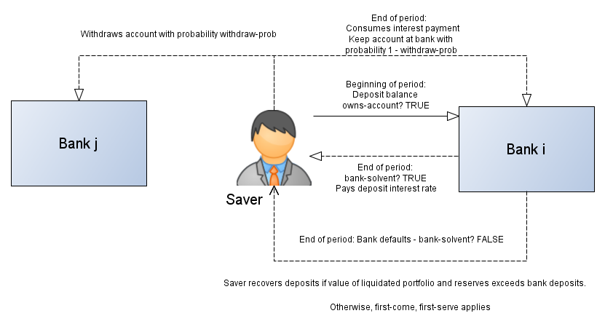
Savers

Slide 14
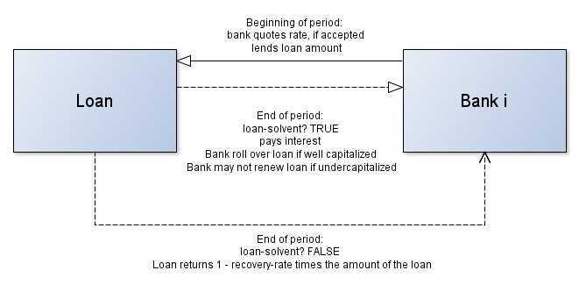
Loans

Slide 15
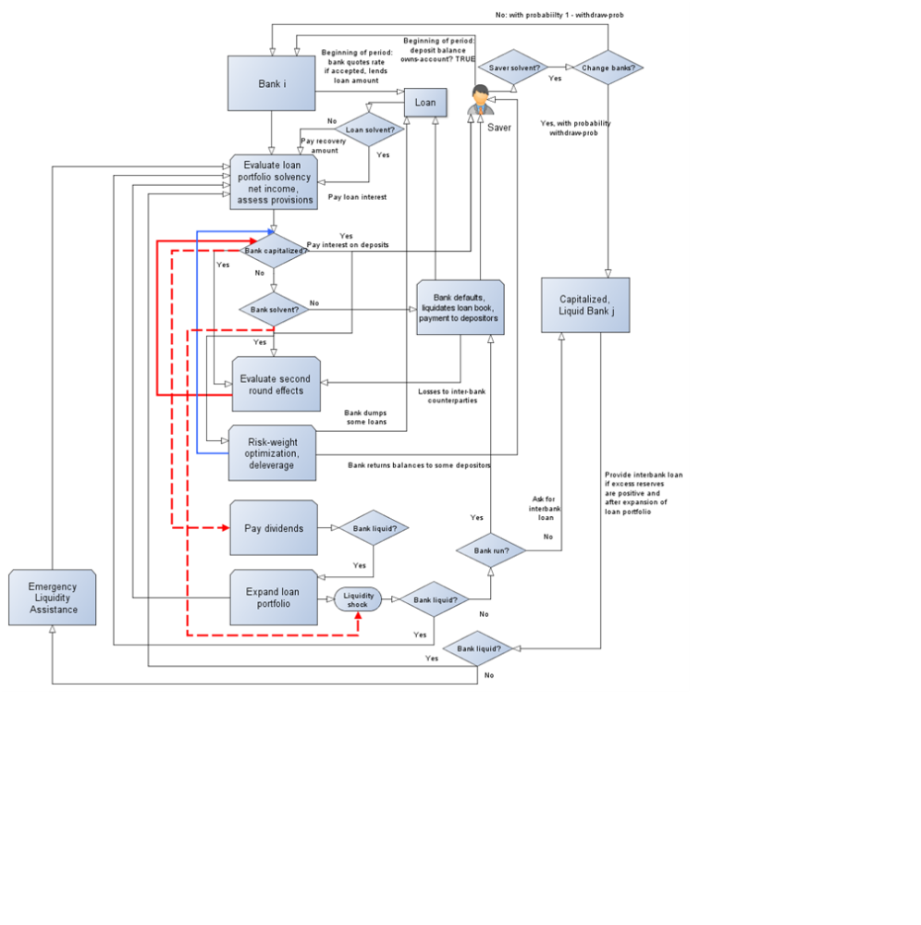
Banks

Slide 16
Banks: Sequence of actions
Setup initial loan portfolio
Iterations
  Calculate net income and losses in loan portfolio
  Evaluate capital adequacy and solvency
  Evaluate second round effects
  Rebalance loan portfolio, e.g. risk-weight optimization (if needed)
  Pay dividends
  Expand loan portfolio
  Access interbank markets (if needed)

Slide 17
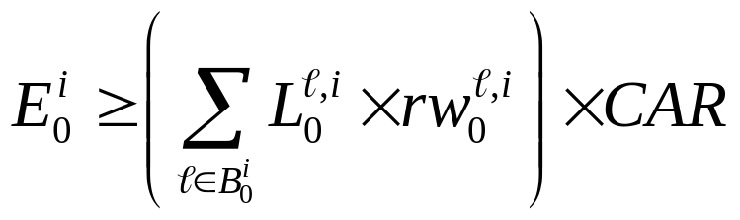
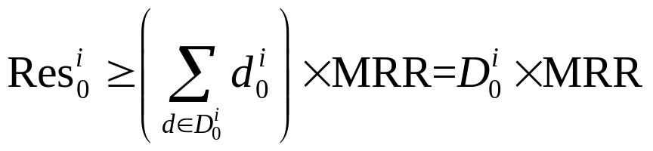
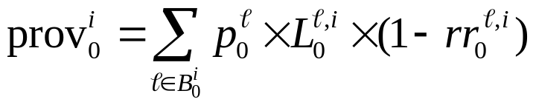
Banks: Initial Loan Portfolio
Equity
Reserves
Equity
Loans
Reserves
Deposits
Deposits
1) Check capital against CAR
2) Check reserves against reserve requirements
3) Provision against expected loss

Slide 18

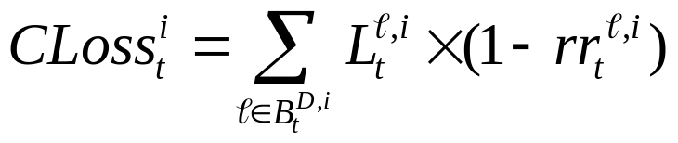




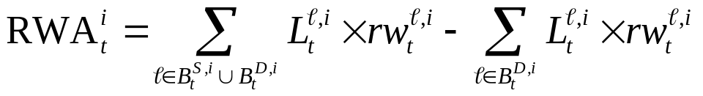

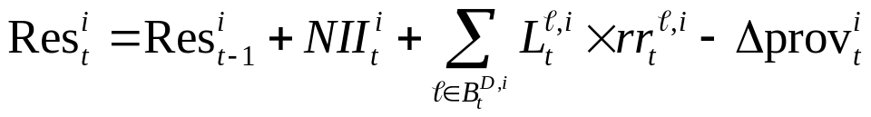
Banks: Solvency Evaluation
Net interest income
Credit losses
Change provisions
Change RWA
Equity change
Reserve change

Slide 19
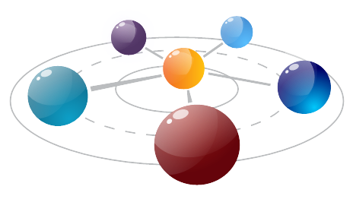


Interconnectedness
Capitalized but illiquid bank
Interbank loan
Interbank loan
Solvent banks with excess reserves

Slide 20

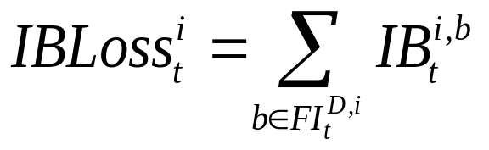

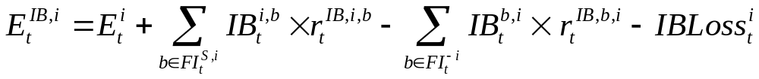
Banks: Second-Round Effects
Creditor banks
Debtor banks
Equity
Reserves

Slide 21


Banks: second-round effects
Keep going until no more banks fail …

Slide 22
Banks: Risk-Weight Optimization
Solvent bank but undercapitalized
Deleverage balance sheet (risk-weight optimization)
  Remove loan from portfolio
    Loan liquidation losses but ...
  Stronger capital position
    Reduce risk-weighted assets
    Release provisions
Process
  Optimization
  Sequential deleveraging

Slide 23
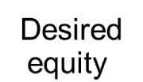
Banks: Dividend Payment
Excess Equity
Banks may hold more equity than desired
Equity
Reserves
Reserves
Excess equity paid as dividends
Loans
Deposits
Dividends paid from reserves
If excess reserves available ex-post dividend, extend more loans
Note: Dividend payments could be
motivated by excess reserves
Dividends

Slide 24





Banks: Liquidity Shocks
Bank A
Outflows
Capitalized and illiquid: interbank market
Solvent and illiquid: emergency liquidity assistance
Insolvent and illiquid: liquidation; loss sold at fire-sale value
Bank B
Inflows
(only if bank A is well capitalized)
Bank C

Slide 25
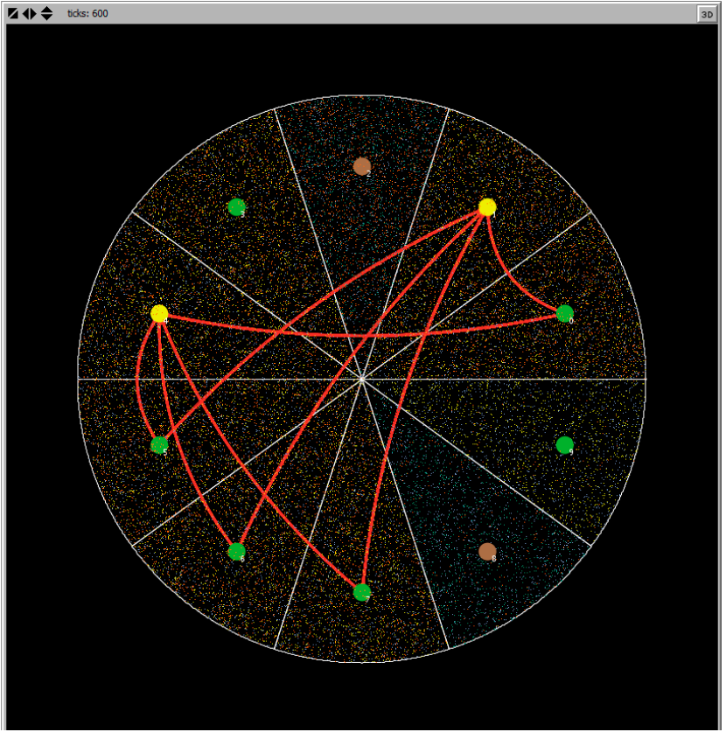

Slide 26
Banks

Slide 27
An Application:
Regulatory Requirements

Slide 28
Simulation: Assumptions and Details
World composed of 10 regions
Savers per region: 10000
  Withdraw probability in [0, 0.20]
  Deposits = 1
  Deposit rate = 1 percent
Potential loans per region: 20000
  Loan amount = 1
  Probability of default in [0, 0.10]
  Risk weight of loan = 0.5 + 0.5 x PD
  Recovery given default = 40 percent
  Return = markup over fair rate
  Fire-sale loss = {0, 1, 2, …, 10} percent

Slide 29
Simulation: Assumptions and Details
Banks
  One per region
  Initial equity = 100
  Target reserve ratio = 1.5 x required ratio
  Target capital ratio = 1.5 x CAR
  Interbank loans rate = 1 percent
Regulatory requirements
  CAR = 4, 8, 12, and 16 percent
  Reserve ratios = 3, 4 ½, and 6 percent
Simulations
  10 000 for each combination of CAR and RR
  240 periods

Slide 30
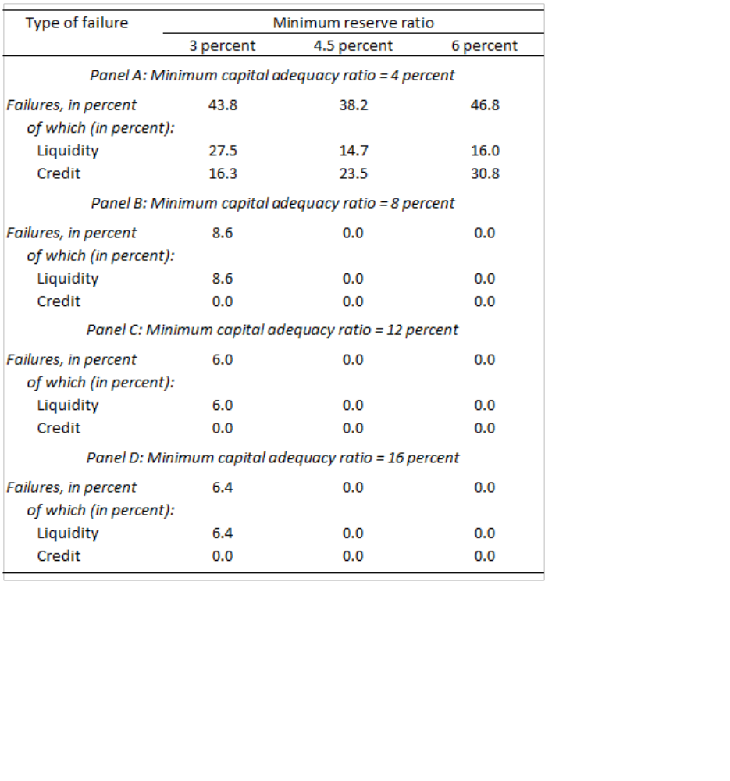

Bank Failures

Slide 31
Bank Failures
Low regulatory CAR and high reserve ratios
  Reduce liquidity failures ...
  … but increase credit failures
High reserve ratios
  More difficult to hold excess reserves
  Without excess reserves
    Risk-weighted optimization unfeasible when needed
    Credit shocks gradually deplete capital buffer
For high CAR, only liquidity failures
High reserve ratios and high CAR are needed

Slide 32
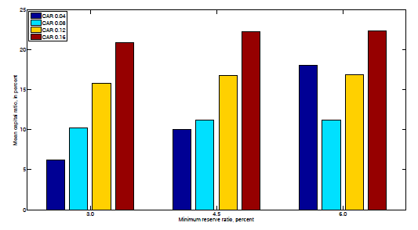
Mean Capital Ratio
When CARs, are high, banks meet target capital ratios, regardless of required reserves
… but not when CAR is low
As reserve requirements increase, it is more difficult to distribute dividends
… leading to higher capital

Slide 33
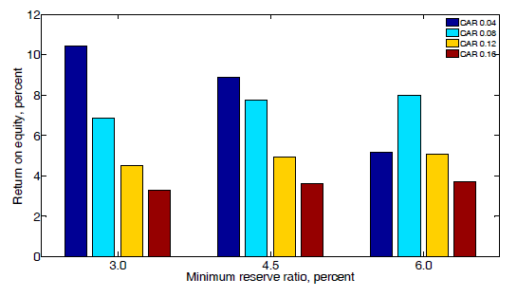
Mean Return on Equity
Higher CAR leads to lower ROE, keeping MRR constant
But not in this case

Slide 34
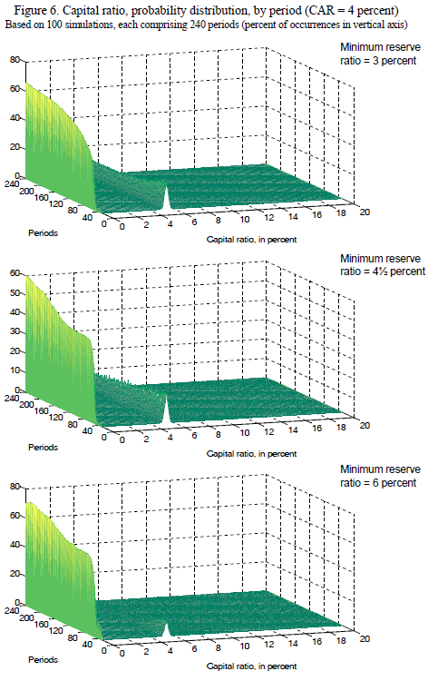
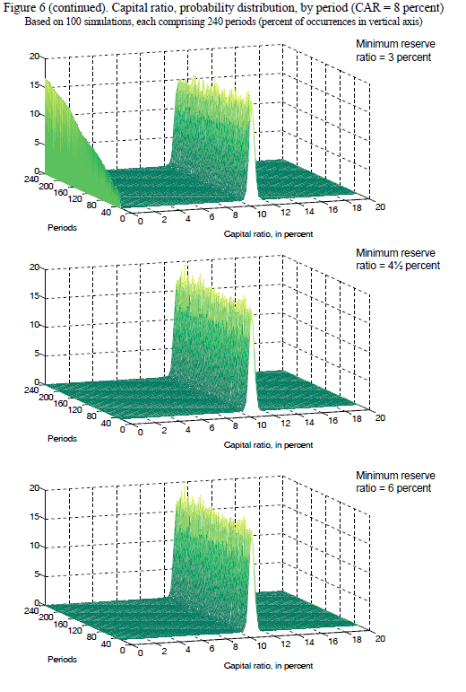

Slide 35
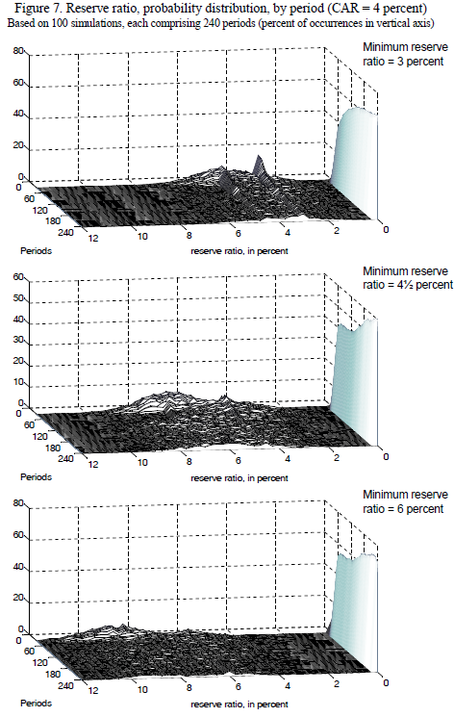
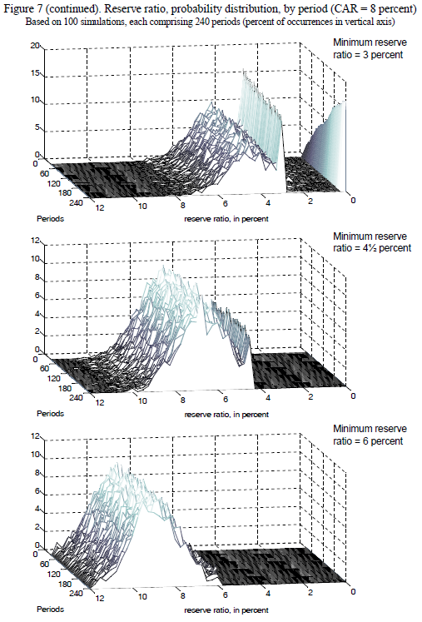

Slide 36
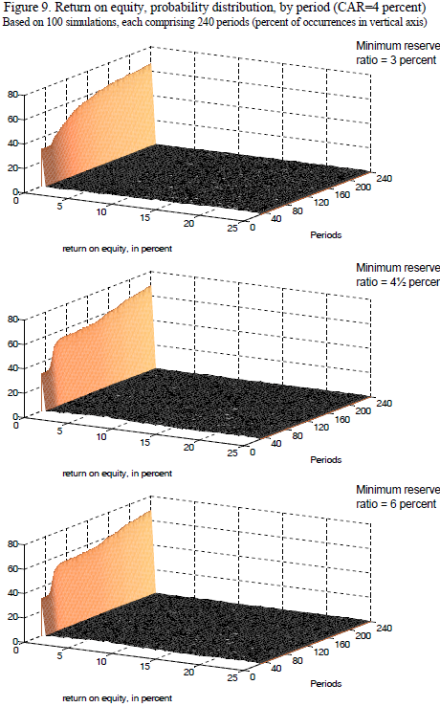
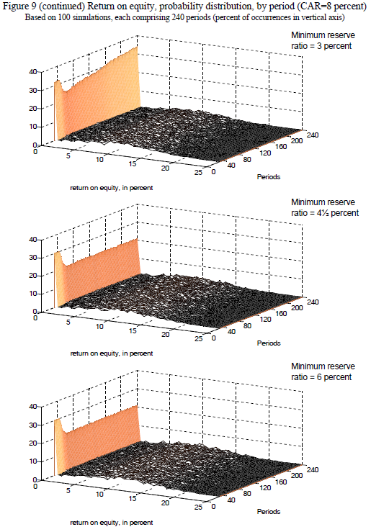

Slide 37
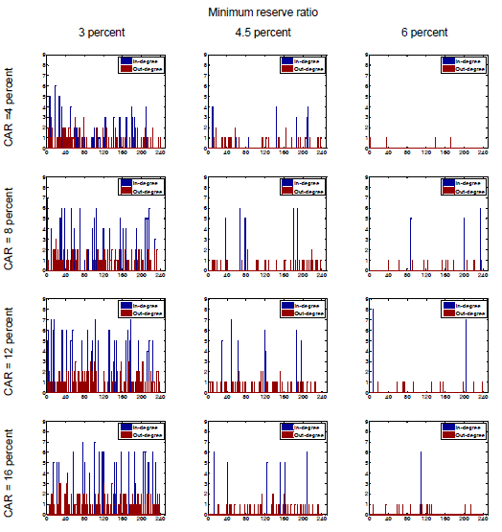
Interconnectedness
Representative bank
240 periods
In-degree: receive interbank loan
Out-degree: provide interbank loan
For fixed reserve requirement, interconnectedness increases with higher CAR requirements

Slide 38
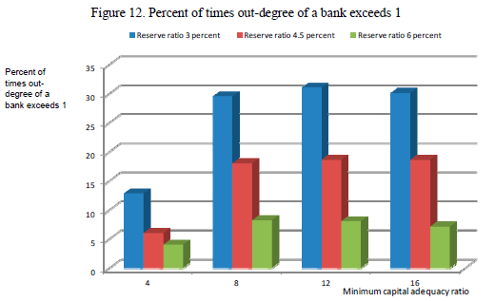
Interconnectedness
For fixed CAR, declines with higher reserve ratios

Slide 39
Conclusions and Going forward

Slide 40
Conclusions
ABMs capture complex dynamics, diverse behavior
ABBA incorporates
  Endogenous bank network formation
  Endogenous dividend payment rules
  Risk-weight optimization
  Loan portfolio expansion
Regulatory requirements application
  Low CARs and higher MRR: more credit failures
  High CARs: more interconnectedness
  CAR and MRR
    Not analyzed in isolation
    Design to look at loan portfolio characteristics, saver and bank behavior

Slide 41
Going forward
ABBA model extensions
  Incorporate wholesale investors
  Collateralized loans
  Social network effects of savers
  Region-based model helpful to analyze international banking

Slide 42



Going Forward: Macrofinancial models
Macro shocks affecting PDs, interest rates, etc
Macro
Model
ABBA
Model
Banking/finance shocks affecting credit supply, etc

Slide 43
References
Axtell, R., D. Farmer, J. Geanakoplos, P. Howitt, E. Carella, B. Conlee, J. Goldstein, M. Hendrey, P. Kalikman, D. Masad, N. Palmer, and C. Yang, 2014, “An Agent-Based Model of the Housing Market Bubble in Metropolitan Washington D.C.” mimeo (George Mason University, Oxford University, Yale University and Brown University)
Anselmo, P. and M. Planck, 2012, “Solvency Dynamics of an Evolving Agent-Based Banking System Model,” Working Paper, New Mexico Institute of Mining and Technology
Aymanns, C., and J.D. Farmer, 2014, “The Dynamics of the Leverage Cycle,” Working Paper, Oxford University
Bookstaber, R., M. Paddrik, and B. Tivnan, 2014, “An Agent-Based Model for Financial Vulnerability,” Office of Financial Research, WP 14-05, U.S. Department of the Treasury (Washington, D.C.)
Chan-Lau, J.A., 2013, Systemic Risk Assessment and Oversight (London: Risk Books)
Complexity Research Initiative for Systemic Instabilities (C.R.I.S.I.S.) http://www.crisis-economics.edu
Georg, C.-P., 2013, “The Effect of Interbank Network Structure on Contagion and Common Shocks,” Journal of Banking and Finance 37 (7).
Grilli, R., G. Tedeschi, and M. Gallegati, 2012, “Markets Connectivity and Financial Contagion,” Working Paper No. 382, Universita Politecnica delle Marche
Ismail, O., 2012, “An Agent-Based Computational Model for Bank Formation and Interbank Networks,” Ph.D. dissertation, School of Computational Engineering and Science, McMasters University
Klinger, T., and P. Teply, 2014, “Systemic Risk in the Global Banking System – an Agent-Based Network Model Approach,” Prague Economic Papers 1, pp. 24–41
Lenzu, S., and G. Tedeschi, 2012, “Systemic Risk on Different Interbank Network Topologies,” Quaderno di Ricerca No. 375, Universita Pollitechnica delle Marche
Montagna, M., and C. Kok, 2013, “Multi-layered Interbank Model for Assessing Systemic Risk”, Kiel Working Papers No. 1873, Kiel Institute for the World Economy

Slide 44
Thank You !

